Slide 1


Understanding the management of massive resources

Slide 2


Today's agenda
Project recap
Problem
The Analytics team
Process
Insights
Summary

Slide 3


An audit for big data practice
Recommendations for a successful IPO
An analysis of content categories that highlights the top 5 categories with the largest aggregate popularity
Project Recap

Slide 4


Problem
Scale was a big problem of Social Buzz and they need to manage the massive scale with the resources that they currently have.

Slide 5



Andrew Fleming (Chief Technical Architect)
The Analytics team
Supriya Sonone
(Data Scientist)
Marcus Rompton (Senior Principle)

Slide 6

Collecting Data
Process
1
Data Cleaning
2
Data Modelling
3
Data Analyzation
4

Slide 7


Insights
There are 16 Unique Categories as follows:
Studying
healthy eating
Technology
Food
Cooking
Dogs
Soccer
Public Speaking
Science
Tennis
Travel
Fitness
Education
Veganism
Animals
Culture

Slide 8
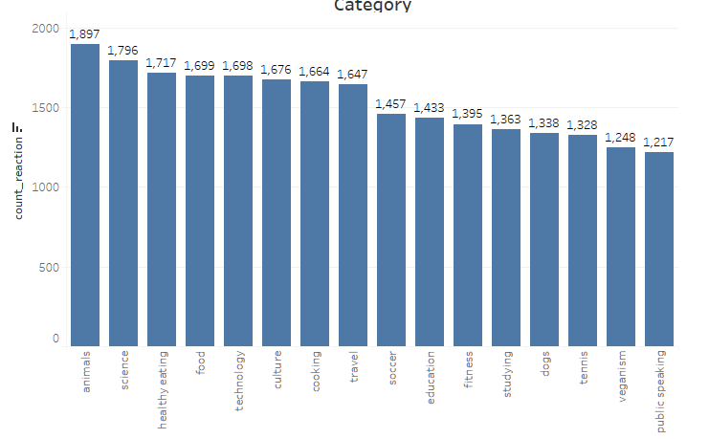
Here we can see that for the most popular category the reactions are 1897

Slide 9
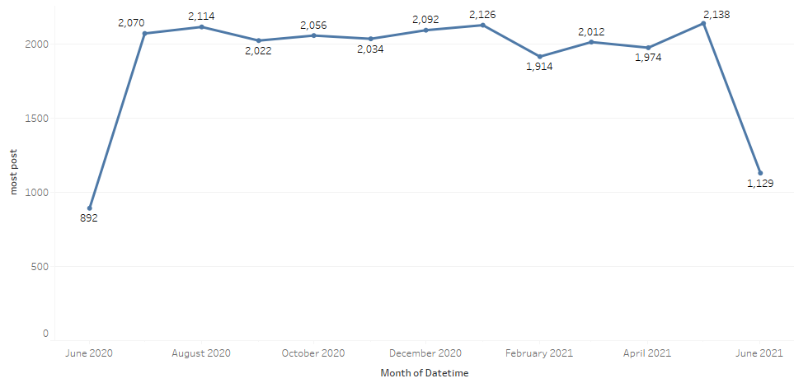
Here in May 2021 there were the highest post of around 2138

Slide 10


Analyzed the Social Buzz content categories that highlights the top 5 categories with the largest aggregate popularity
Summary

Slide 11

Thank you!
ANY QUESTIONS?

